Slide 1

Team Name: EXPLORER’S GUILD
Theme: Modern Minimalism
Project Title: CASUAL CUM FORMAL SHOES
S.No | Name of the student | Year/Dept. | Email Id | Contact Number
1 | Kabilesh Sudhan S A | 2nd/ECE | kabileshsudhan.ec23@krct.ac.in | 8870079105
2 | Jaya Suriya K | 2nd/ECE | jayasuriya.ec23@krct.ac.in | 9025648945
3 | Dhivaharan L | 2nd/ECE | dhivaharan.ec23@krct.ac.in | 8760382878
College Name: K Ramakrishnan College Of Technology
Team Leader Name : Kabilesh Sudhan S A

Slide 2
CASUAL CUM FORMAL SHOES
KABILESH SUDHAN S A -ECA23045
JAYA SURIYA K -ECA23041
DHIVAHARAN -ECA23022

Slide 3
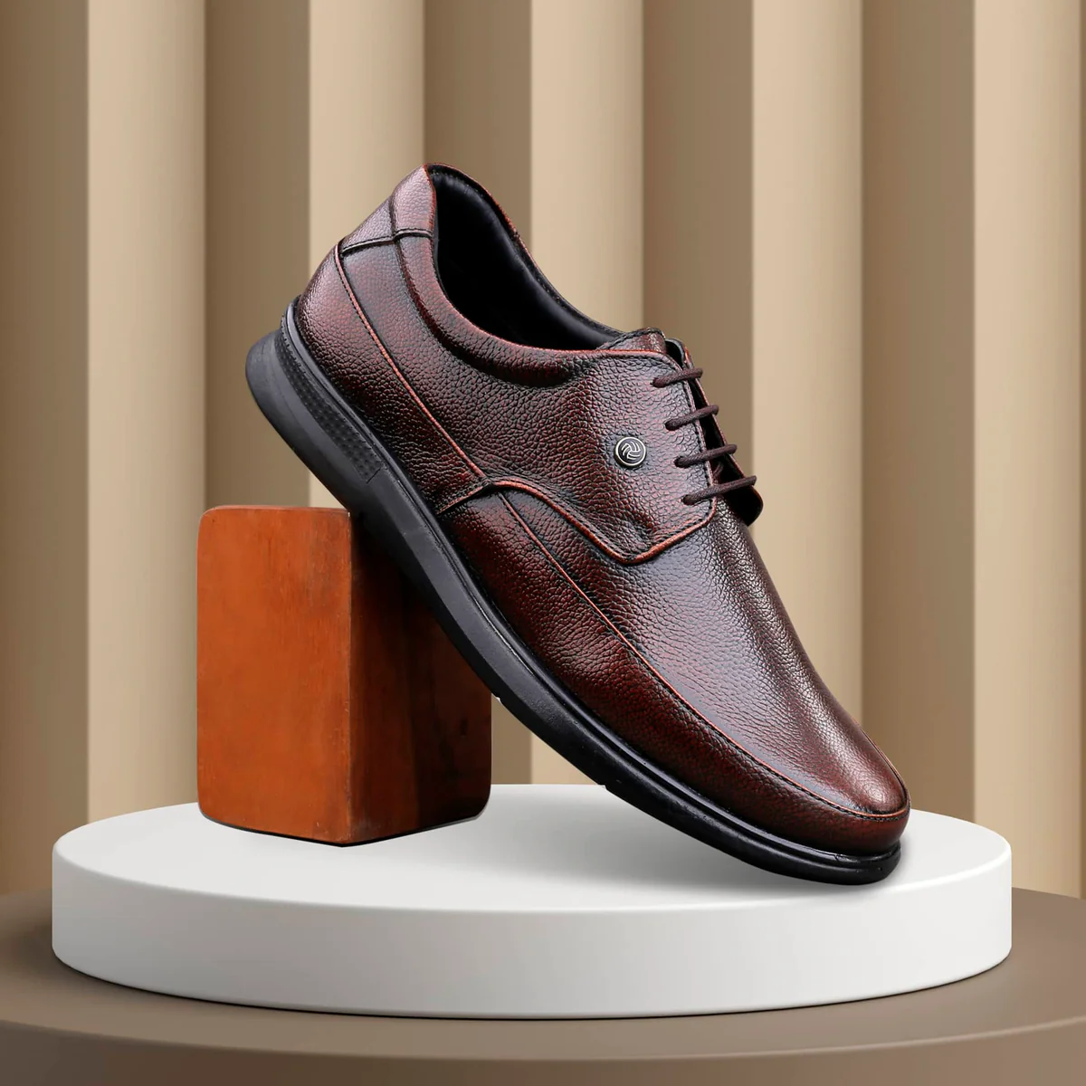

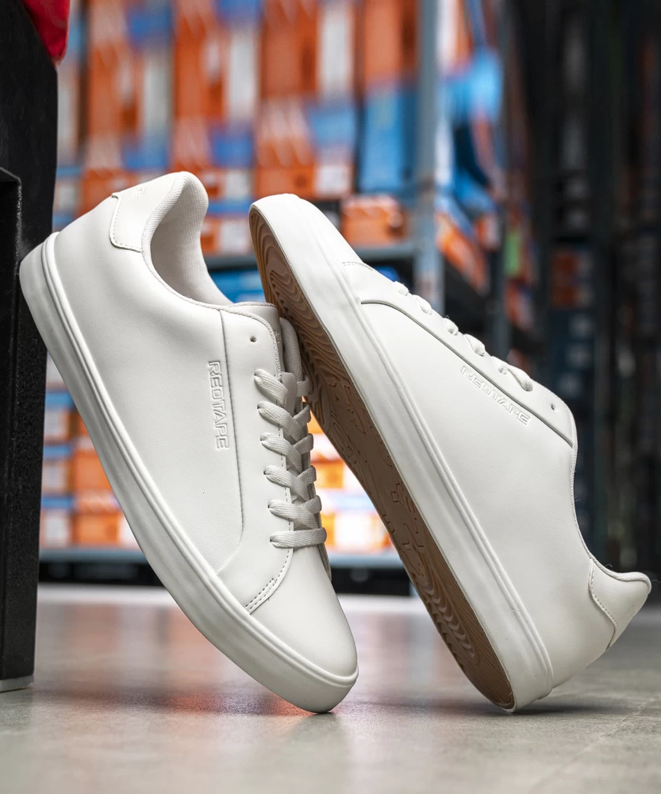
Existing Product Detail

Slide 4
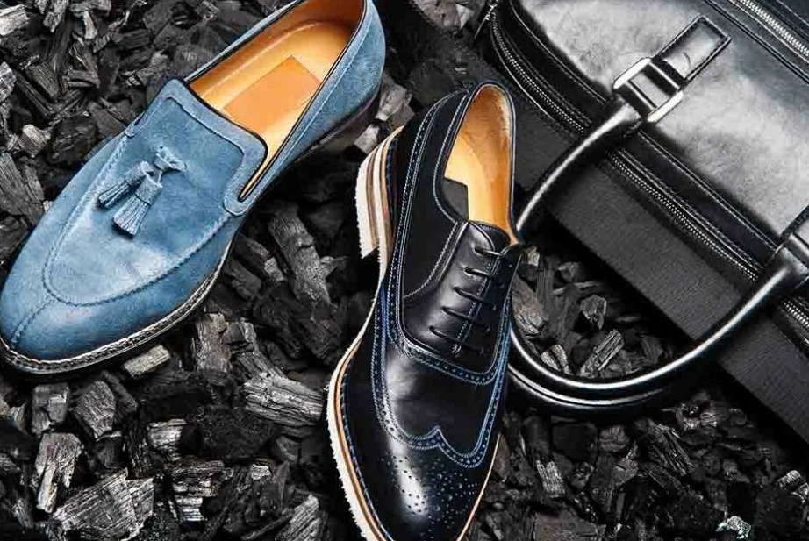
Problem Statement
It is impossible for a versatile shoe that seamlessly blends casual comfort with formal aesthetics, suitable for various occasions
The shoe should offer durability and style while maintaining a minimalist design that fits both relaxed and professional settings.

Slide 5
Solution Concept
The proposed solution combines a hybrid design, advanced comfort technology, and versatile styling to create a shoe that meets the needs of both casual and formal environments, offering both practicality and style.
This product is ideal for office environments, social gatherings,travelers and individuals with active lifestyles.
The casual-formal shoe solution is designed to enhance comfort and style across multiple settings, making it a valuable addition to both professional and personal life.

Slide 6
Market Size
Rising global middle-class spending power.
Rising Demand for Versatile Shoes.
Rising interest in sustainability Focus.
Consumer focus on long-lasting, eco-friendly options.
E-commerce Expansion.

Slide 7
Target Marketing
Young Professionals
Frequent Travelers
Sustainable Shoppers
Fashion Enthusiasts
Working Parents
Tech-Savvy Consumers
Corporate Clients
College Students

Slide 8
Competitor Analysis
Alternate Solutions:
Versatile footwear for different occasions.
Customizable designs for varied styles.
My Solution Product:
The solution product is a modular shoe with interchangeable uppers and a standardized sole, offering versatility for both formal and casual wear.

Slide 9
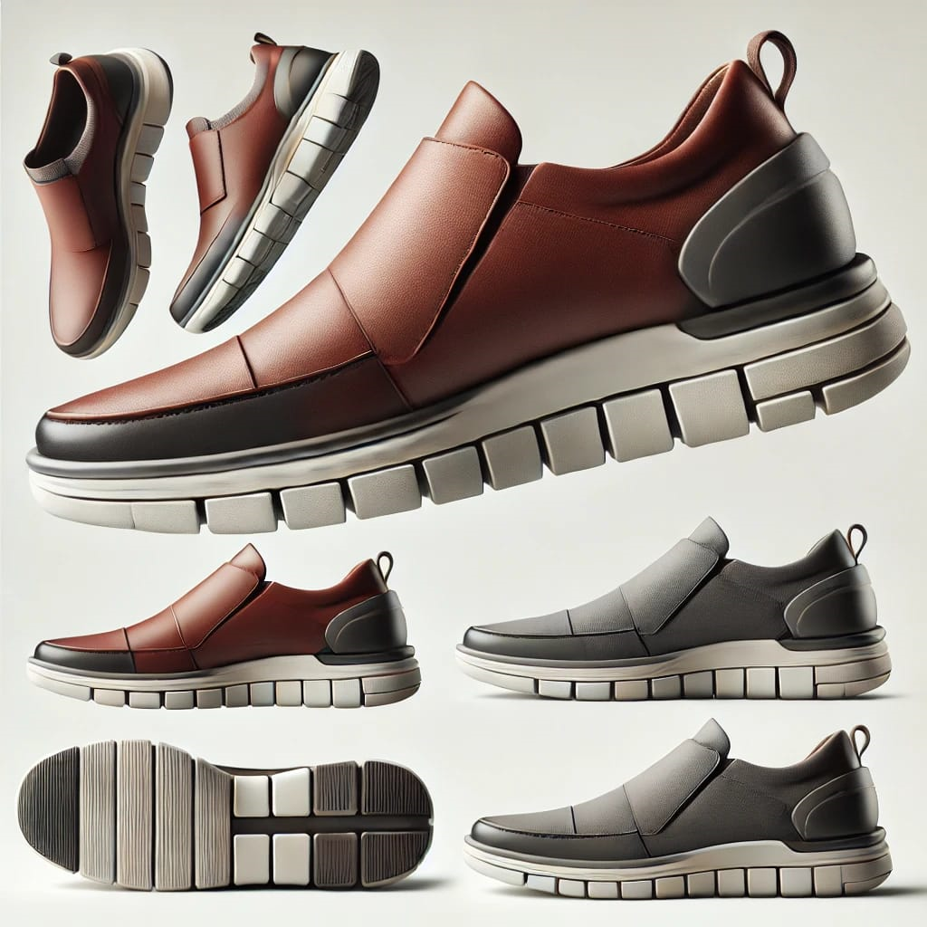
Prototype
The prototype showcases a refined design blending formal elegance with casual comfort. It incorporates premium materials like soft leather and cushioning technologies for optimal wearability. Key features include a flexible sole and ergonomic support to adapt to different environments. The prototype is tested for versatility and durability, ensuring it meets both casual and formal needs.

Slide 10
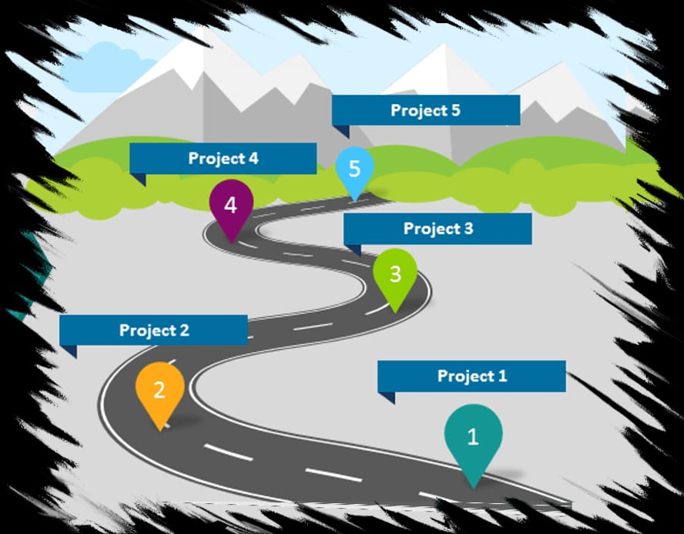
ROAD MAP

Slide 11


